Slide 1


Group
10
EXPLORING THE IMPACT OF PROPERTY CHARACTERISTICS ON TAX CLASSIFICATIONS
IN THE BOROUGHS OF NEW YORK CITY
PADMA SREE MANDA
HARI CHARAN REDDY KARRA
MEHRAN DOVEISIMOGOEI
SAMEER SHAIK

Slide 2

AGENDA
INTRODUCTION
LITERATURE
REVIEW
METHODOLOGY
RESULTS
DISCUSSION
CONCLUSION

Slide 3

INTRODUCTION
RESEARCH TOPIC
RESEARCH QUESTIONS
Develop a machine learning model to classify NYC properties into tax classes.
Utilize structural and ownership features as key predictors.
Enable data-driven decision-making in property assessments.
Support fair, transparent, and efficient tax classification practices.
1. What are the most significant property characteristics influencing the classification of
a property into different tax classes?
2. How do exemptions (e.g., CURACTEXTOT, CURTRNEXTOT, CURTXBEXTOT)
impact the distribution of taxable properties across different classes?

Slide 4

LITERATURE REVIEW
- Gloudemans & Sanderson, 2021
How machine learning techniques can enhance traditional audit selection methods, thus allowing for more effective tax compliance monitoring.
1. Machine Learning Approach for Taxation Analysis using Classification Techniques
- Gloudemans & Sanderson, 2021
Most of the companies or agencies are leaning towards either Gradient Boosting or Neural Networks for property assessments, as they provide more accurate results
2. The Potential of Artificial Intelligence in Property Assessment
- Lee, 2022
Property tax assessment, which demands both accuracy and transparency, could benefit significantly from interpretable machine learning models.
3. Training and Interpreting Machine Learning Models
- McCord, Davis, Bidanset, & Hermans, 2022
compares traditional multiple regression analysis with advanced machine learning
Learning methods like ridge, lasso, elastic net, and geospatial approaches such as eigenvector spatial
4. Prediction Accuracy for Property Tax Mass Appraisal
5. Measuring the Impact of Taxes and Public Services on Property Values
- Grodecka-Messi & Hull, 2022
Compares Double machine learning (DML) to simpler methods like OLS
regression, showing DML produced more accurate and unbiased results

Slide 5





METHODOLOGY
DATASET
DATA PREPROCESSING
MODEL
EVALUATION
Property Valuation and Assessment Data Tax Classes
(NYC Open Data)
6.98 million rows- 139 Columns
800,000 records from Borough 1 (Manhattan)
Handling missing values
encoding categorical
features, scaling numerical features,
assumption testing
Lasso for feature importance,
Logistic Regression, Decision Tree, and Random Forest
Accuracy: 0.99
Best precision and recall scores for the class with the smallest number of instances

Slide 6
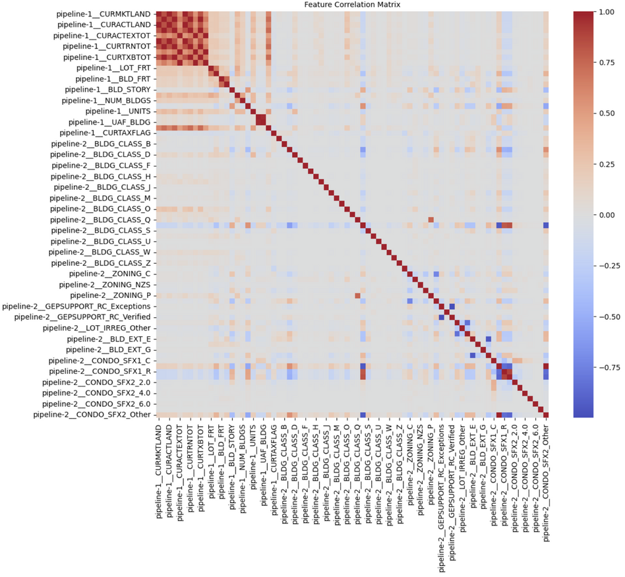
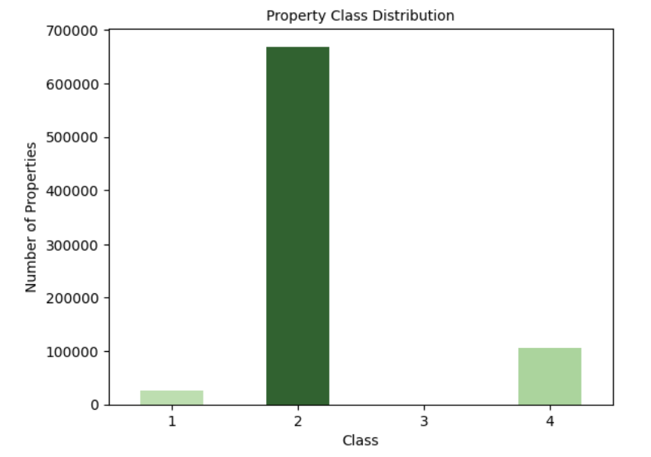



RESULTS (EDA)
Logistic Regression showed the best overall performance.
Handled class imbalance effectively.
Top features: CONDO_SFX_1, BLDG_CLASS, UNITS.
Property type and structure were key to predictions.

Slide 7
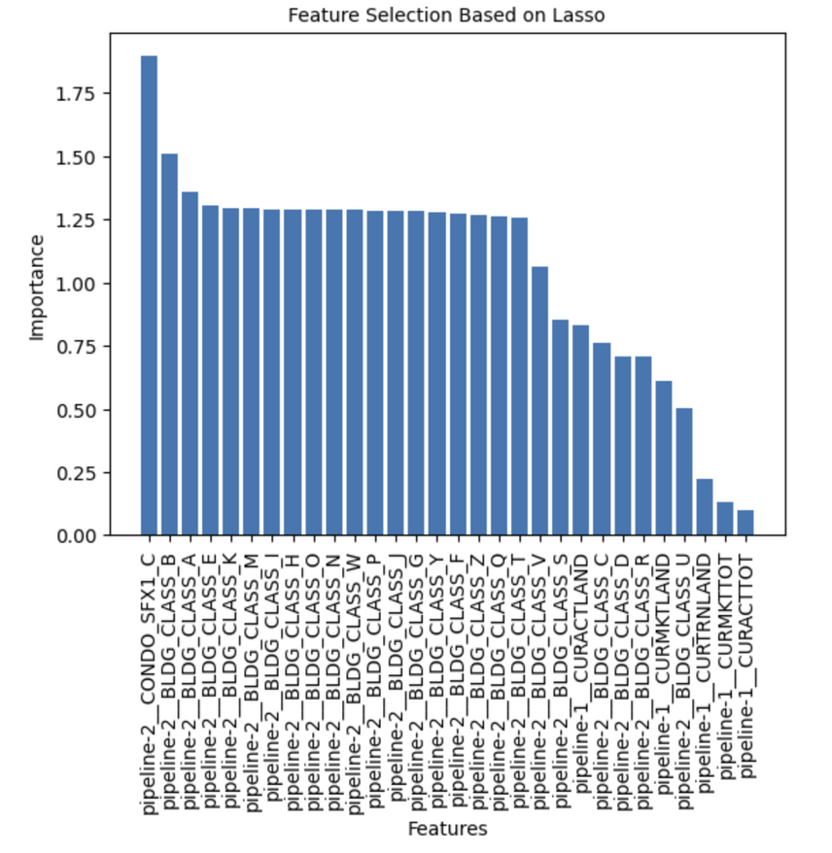
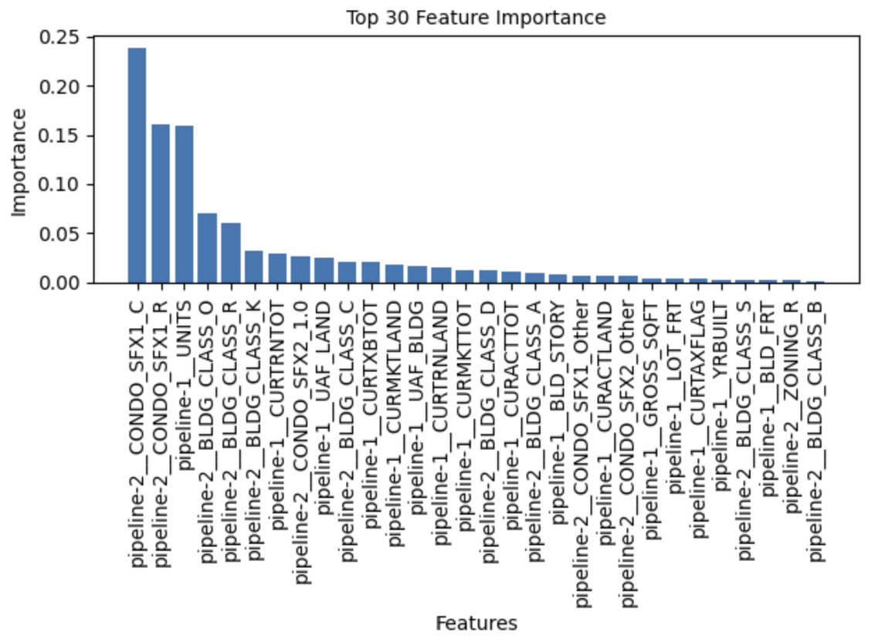
RESULTS
CONDO_SFX1_C and BLDG_CLASS dominate in importance.
Categorical features prioritized over numeric ones.
Lasso filters out low-impact variables.
CONDO_SFX1_C and _R emerged as the most influential predictors.
Property structure features like UNITS and BLDG_CLASS showed high impact.
Feature contributions drop sharply beyond the top 5, indicating strong dominance.

Slide 8
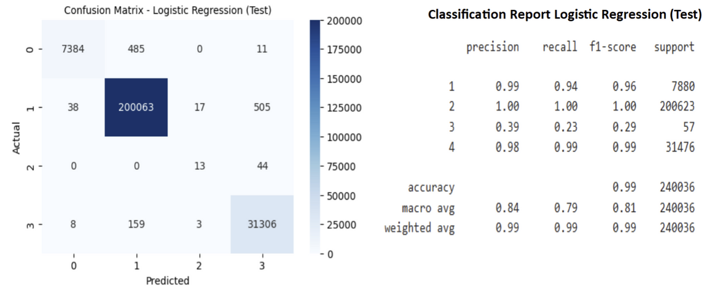
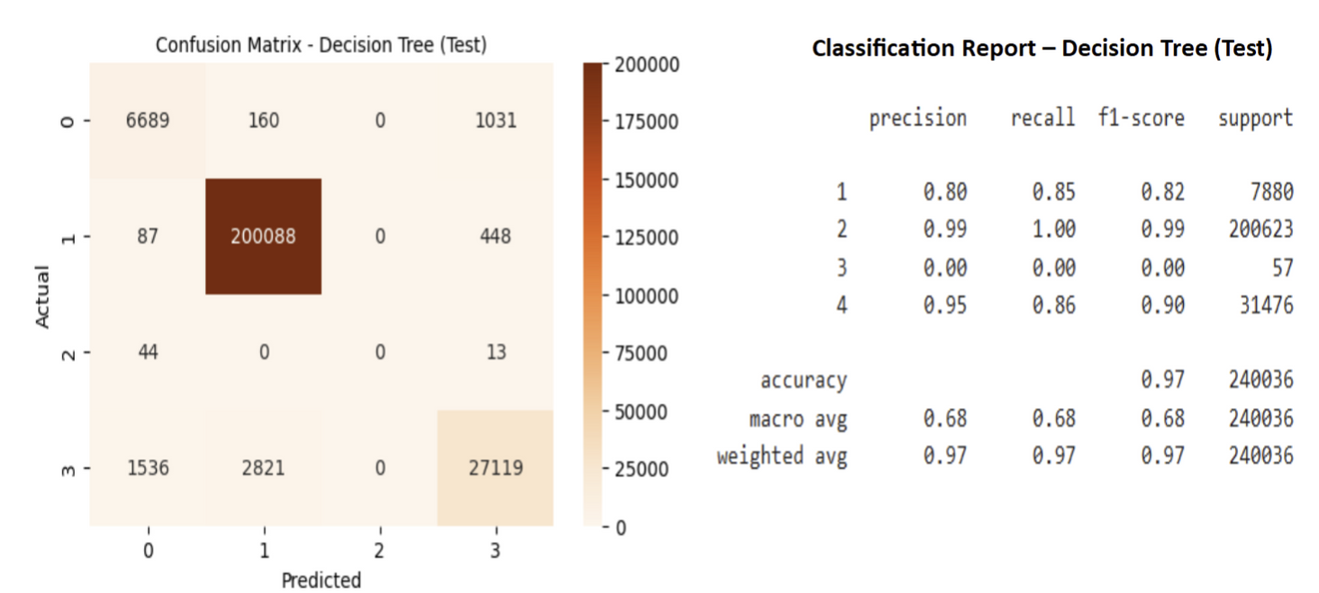
RESULTS
Logistic Regression achieved high accuracy (99%) on the test set.
Class 2 predictions are nearly perfect; Class 4 also shows strong performance.
Class 3 has low precision and recall, indicating difficulty in predicting rare classes.
Class imbalance still impacts macro average scores.
Decision Tree achieved high overall accuracy (97%) on test data.
Class 2 (dominant class) shows near-perfect prediction.
Model failed to classify Class 3 (precision, recall, F1 = 0).
Strong class imbalance likely impacted minority class performance.

Slide 9

DEMO
https://property-tax-assessments.onrender.com/

Slide 10
DISCUSSION
Predicts NYC property tax classes using machine learning with strong accuracy.
Limited model interpretability for policy use.
Class imbalance may inflate accuracy.
Relies on public data quality and completeness.
External factors like exemptions or policy changes are not accounted for.

Slide 11

CONCLUSION
Simplified complex property data to uncover patterns in tax classification.
Supports more transparent, data-informed decision-making.
Provided insights to refine municipal policies and zoning regulations.
May assist in identifying properties for reclassification or further evaluation.
Has the potential to enhance equity and efficiency in the assessment process.

Slide 12
ANY
QUESTIONS

